Slide 1
Basic Coding Course
Week 4 – Functions

Slide 2
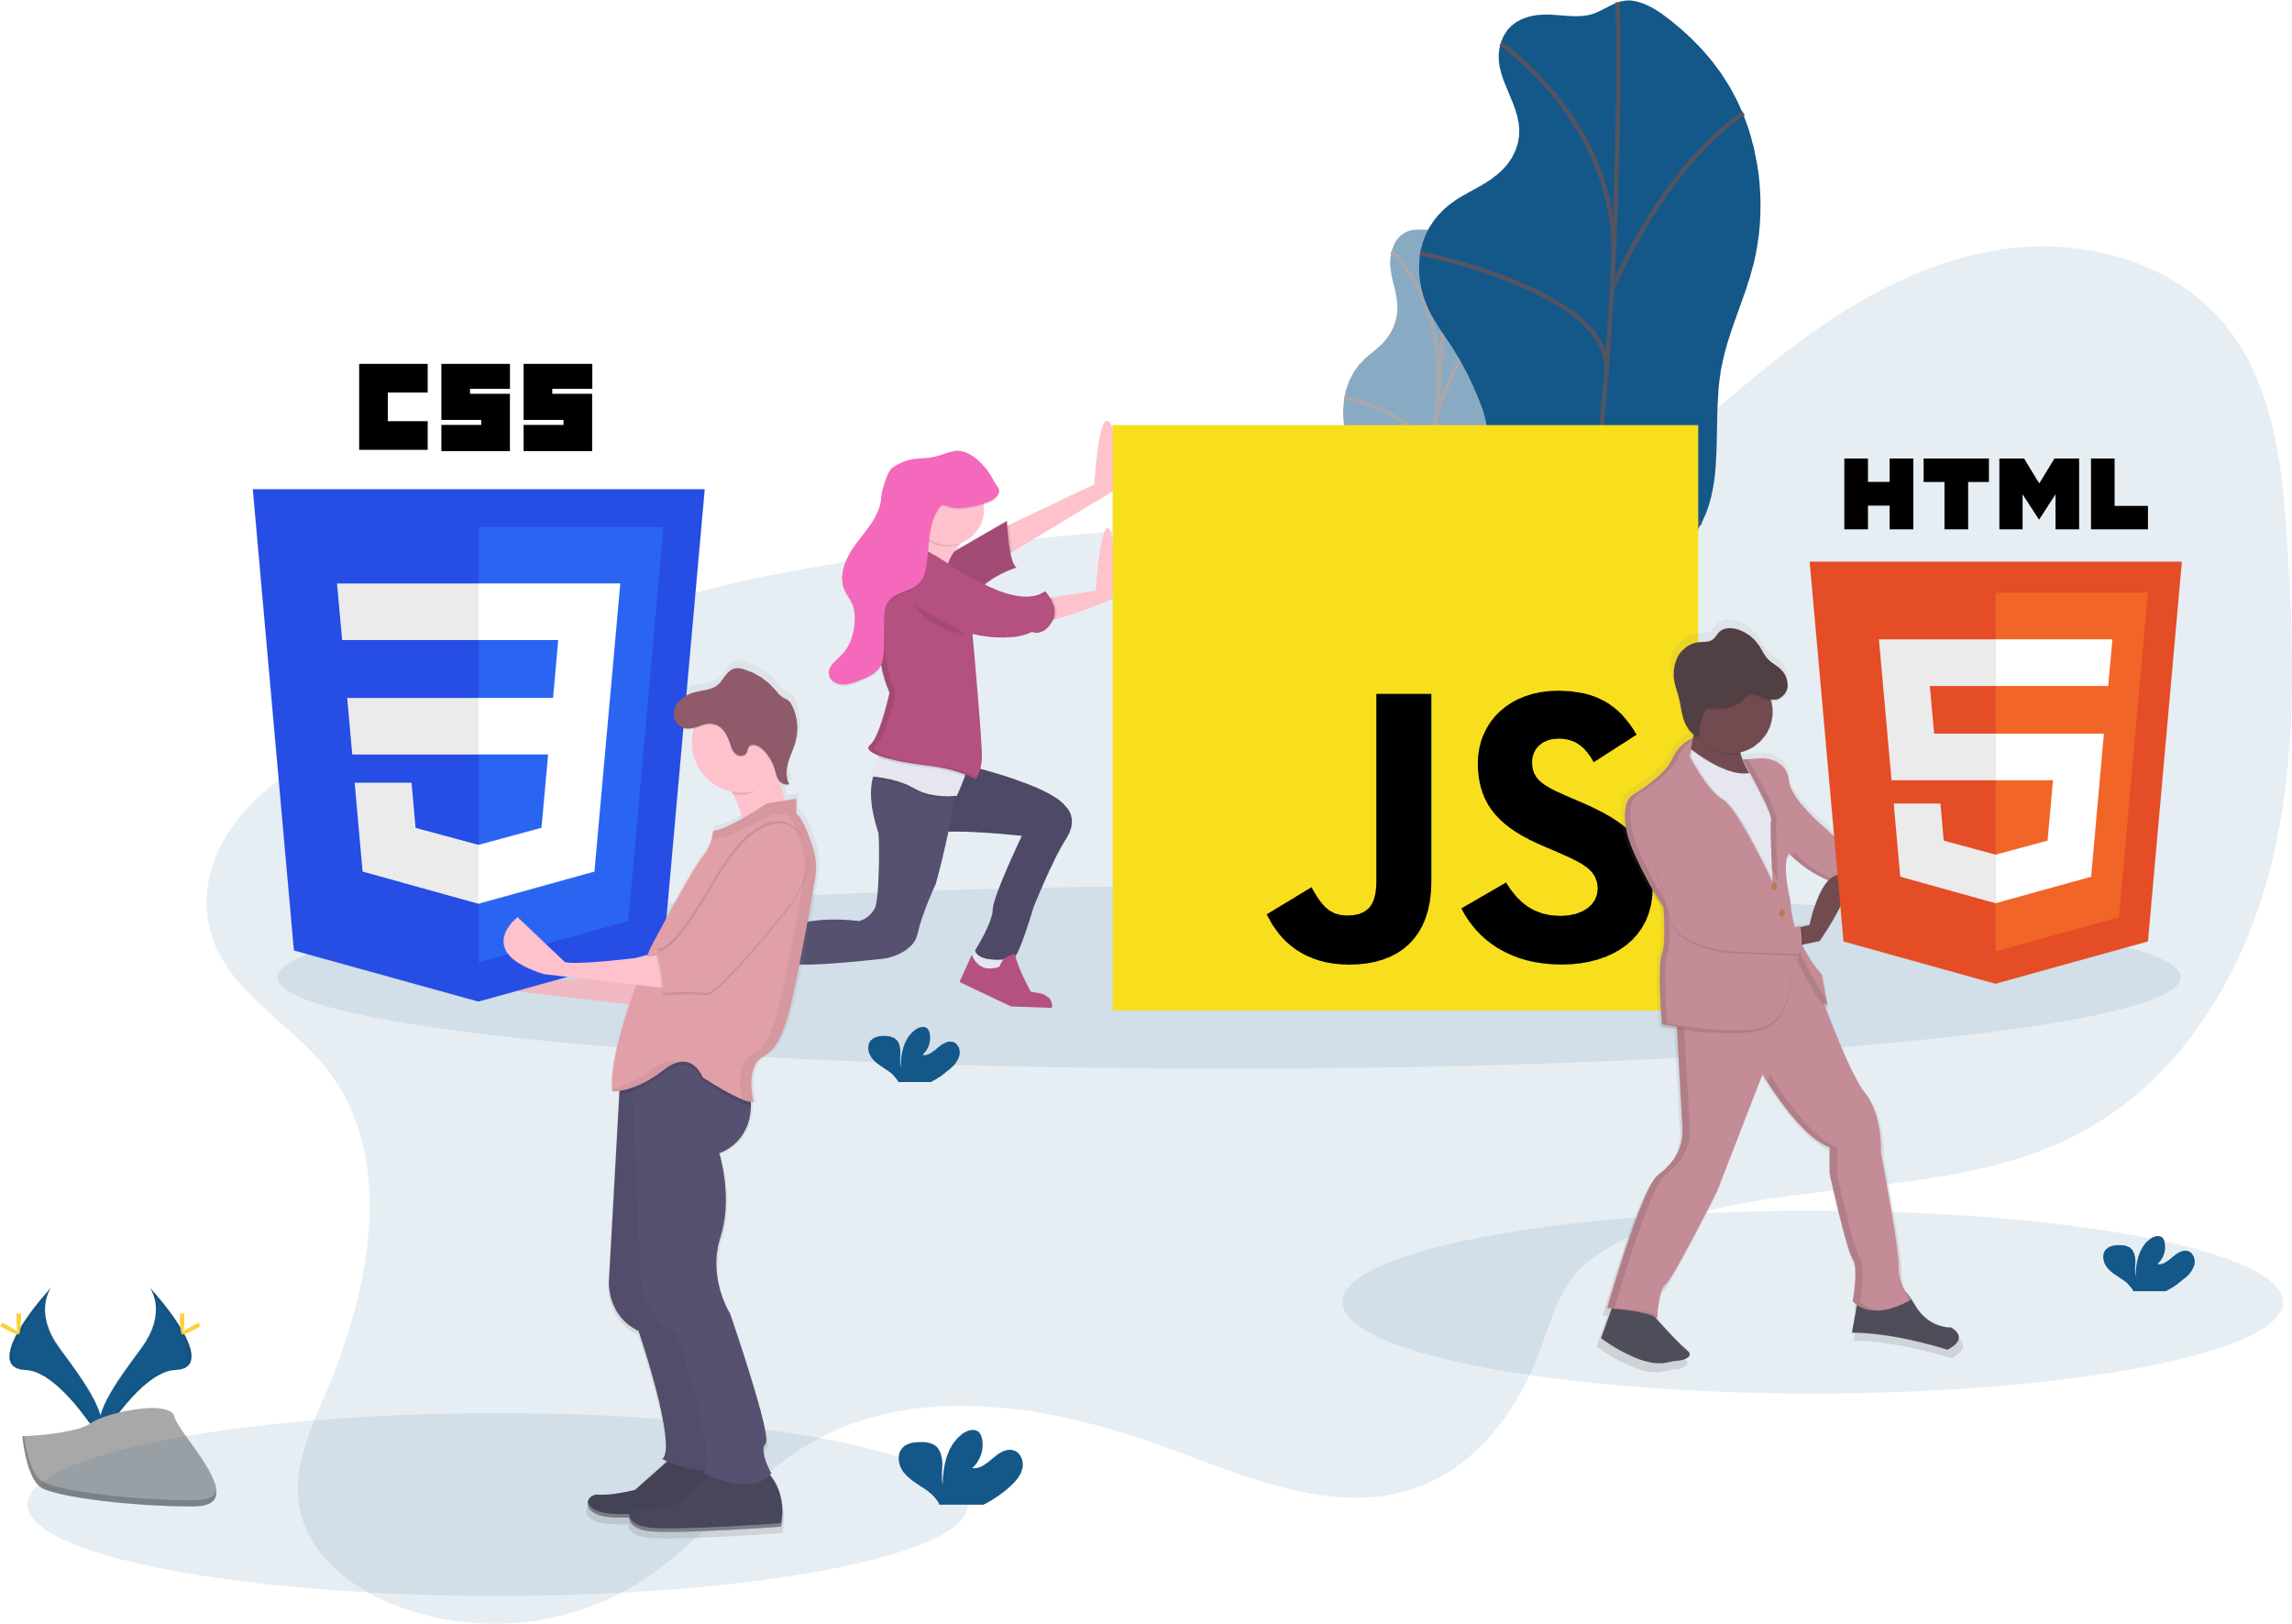
Functions
Section 1

Slide 3
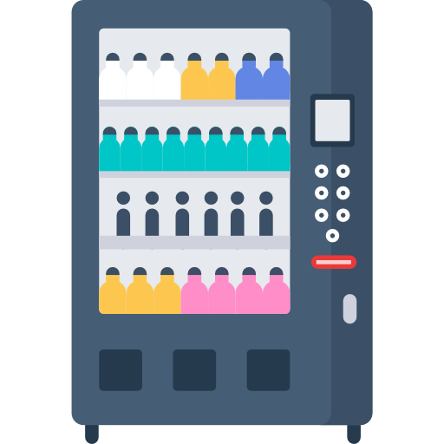

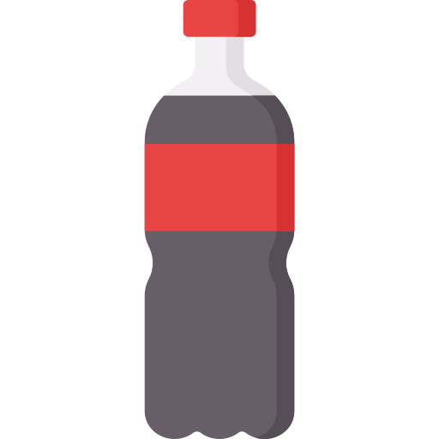

What is Function? (1)
Input
Process
Output
Argument / Parameter
Function

Slide 4
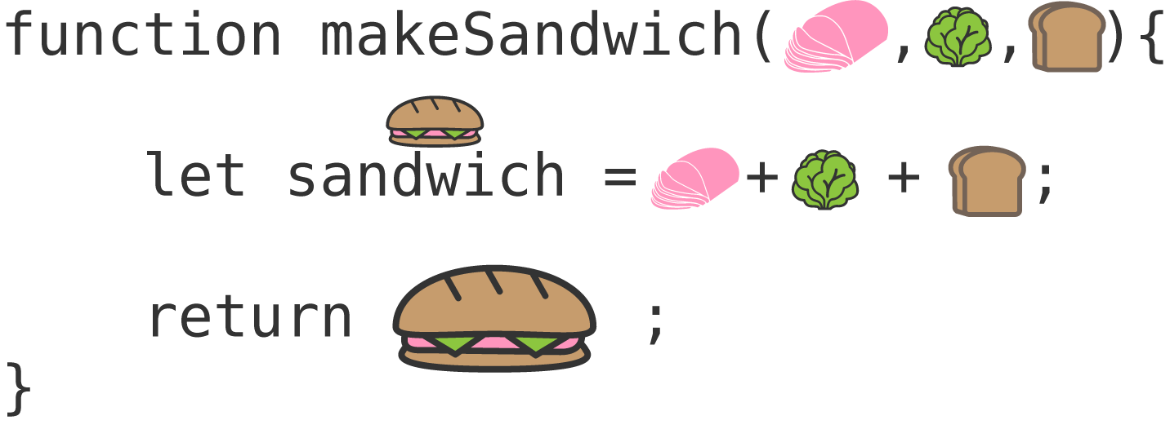
What is Function?
A function in JavaScript is like a reusable set of instructions or a mini-program within your code.
It's designed to perform a specific task or calculate a value when called.
Functions are defined using the function keyword, followed by a name, parentheses (), and curly braces {}.
Functions help keep your code organized and make it more readable (They allow you to reuse the same code in multiple places without duplicating it)
Function Name
Parameter / Argument
Parameters are like placeholders for values that the function needs to work with.

Slide 5
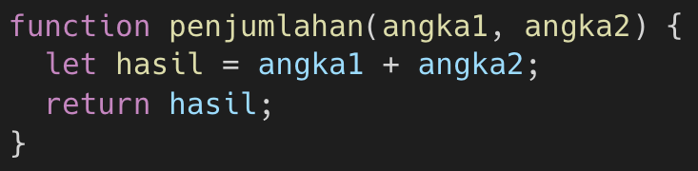
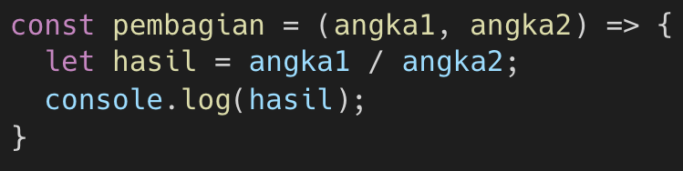
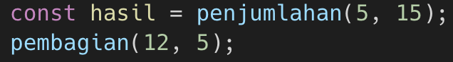
Declaring and Calling Function
Declarative Function
Arrow Function
To execute a function, you "call" it by using its name followed by parentheses.
If the function expects parameters, you pass them within the parentheses.
A function that returns a value
A function that doesn’t returns a value
If the function returns a value, you can directly assign it to a variable

Slide 6
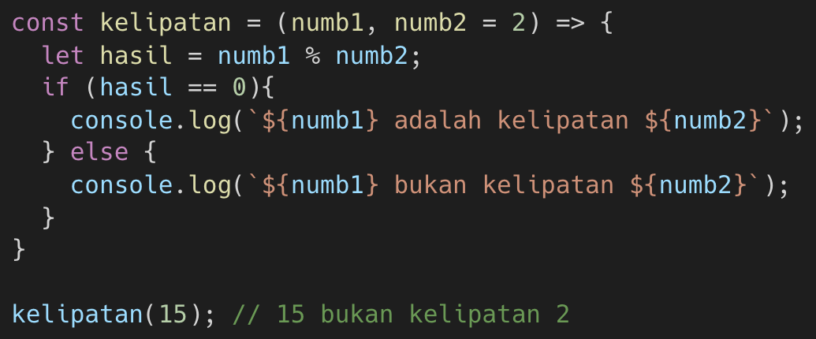
Additional Notes
Functions can have zero or more parameters.
Some functions return a value, while some don’t.
Functions have their own scope, which means variables defined inside a function are not accessible outside of it.
Variables declared outside of functions are considered "global" and can be accessed from anywhere in your code.
You can give default value to a parameter so you can leave the argument empty when calling the function

Slide 7
Additional Array Methods
Section 2

Slide 8
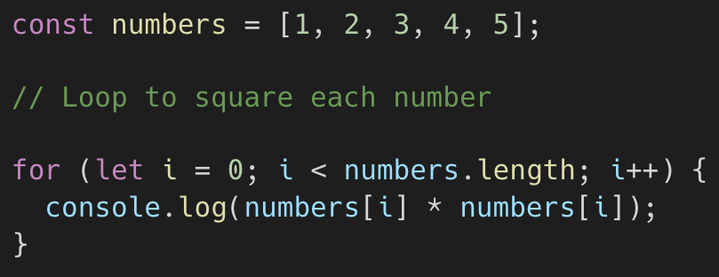
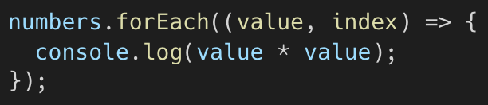
forEach() method
The forEach() method is used to iterate (loop) through each element of an array and perform a specific action or operation on each element.
forEach does not create a new array; it simply iterates through the existing one.
It's often used when you want to perform a side effect on each array element (e.g., printing to the console, updating elements in place).
Equivalent to

Slide 9
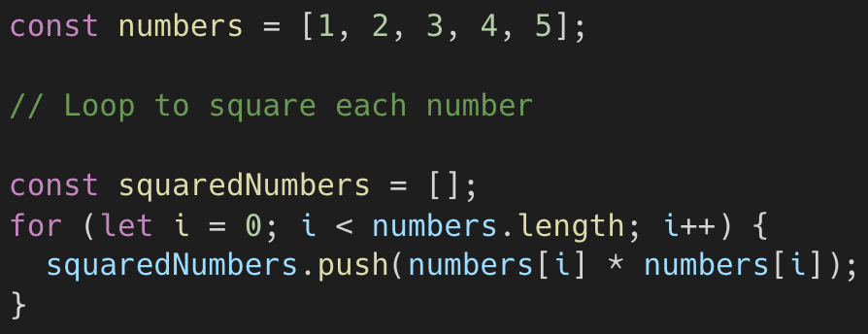
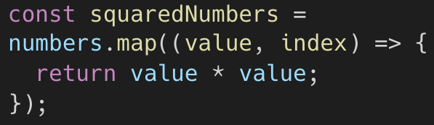
map() method
The map() function is used to create a new array by applying a specified function (callback function) to each element of an existing array.
map creates a new array with the same length as the original one, where each element is the result of applying the callback function.
It's often used when you want to transform data in an array into a new format.
Equivalent to

Slide 10
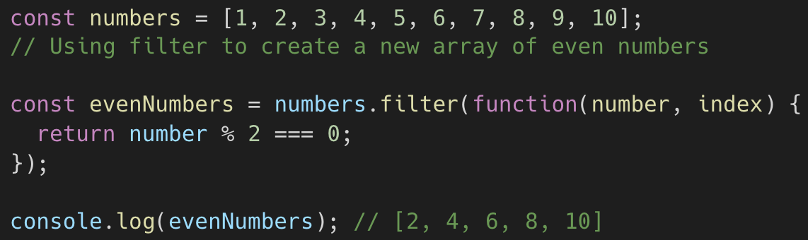
filter() method
The filter() function is used to create a new array that contains a subset of elements from an existing array based on a specific condition or test provided by a callback function.
filter creates a new array that contains only the elements that satisfy the provided condition.
The callback function should return a Boolean value (true or false) to indicate whether an element should be included in the new array.
It's often used when you want to extract elements from an array based on a specific criterion.

Slide 11
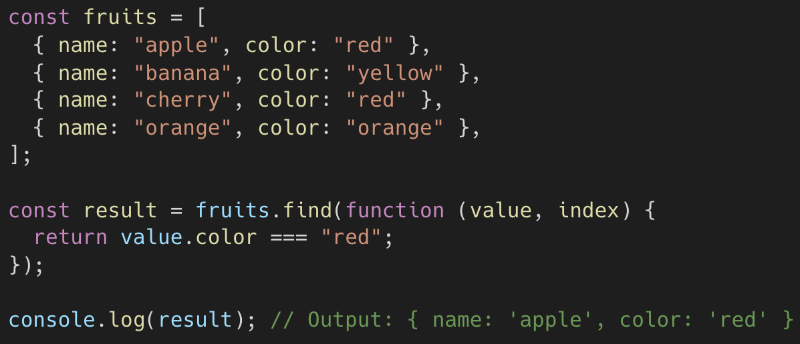
find() method
The find() method is used to find the first element in an array that satisfies a given condition.
It returns the first element for which the provided callback function returns true, and it stops searching once such an element is found.
If no element satisfies the condition, it returns undefined.

Slide 12
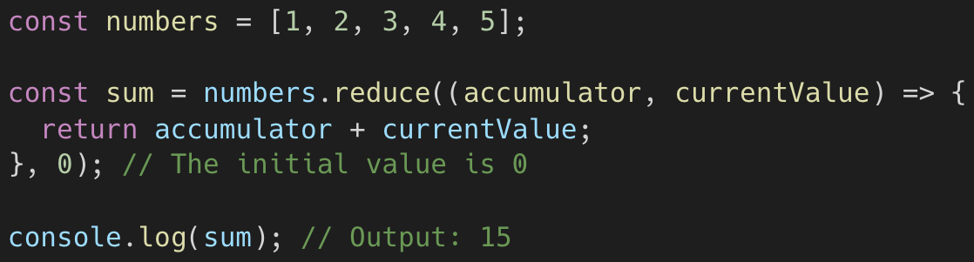
reduce() method
The reduce() method is used to iterate through an array and reduce it to a single value.
It applies a specified function to each element of the array, accumulating a result.
The result can be of any data type (e.g., number, string, object) and is often used for tasks like summing numbers, concatenating strings, or aggregating data.
Accumulator refers to initial value (on first iteration) and previous processed returned value (on the next iteration)
In the above example the accumulator will be (0 → 1 → 3 → 6 → 10)

Slide 13
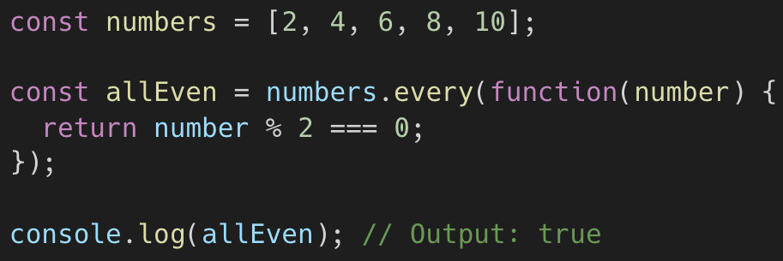
every() method
The every() method tests whether all elements in an array pass a provided condition.
It iterates through the array and checks each element against a callback function.
It returns true if all elements satisfy the condition, and false otherwise.

Slide 14
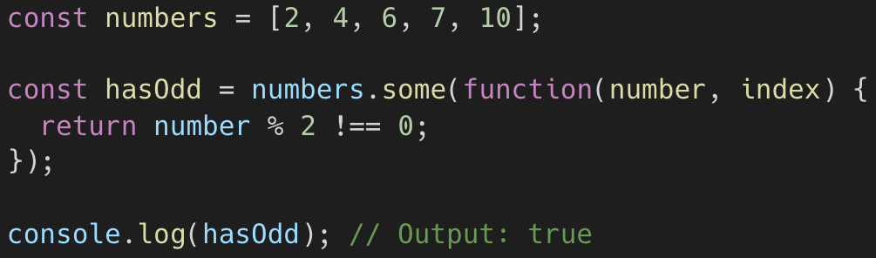
some() method
The some() method tests whether at least one element in an array passes a provided condition.
It iterates through the array and checks each element against a callback function.
It returns true if at least one element satisfies the condition, and false if none of the elements do.

